Slide 1

Intro to VSCode

Slide 2
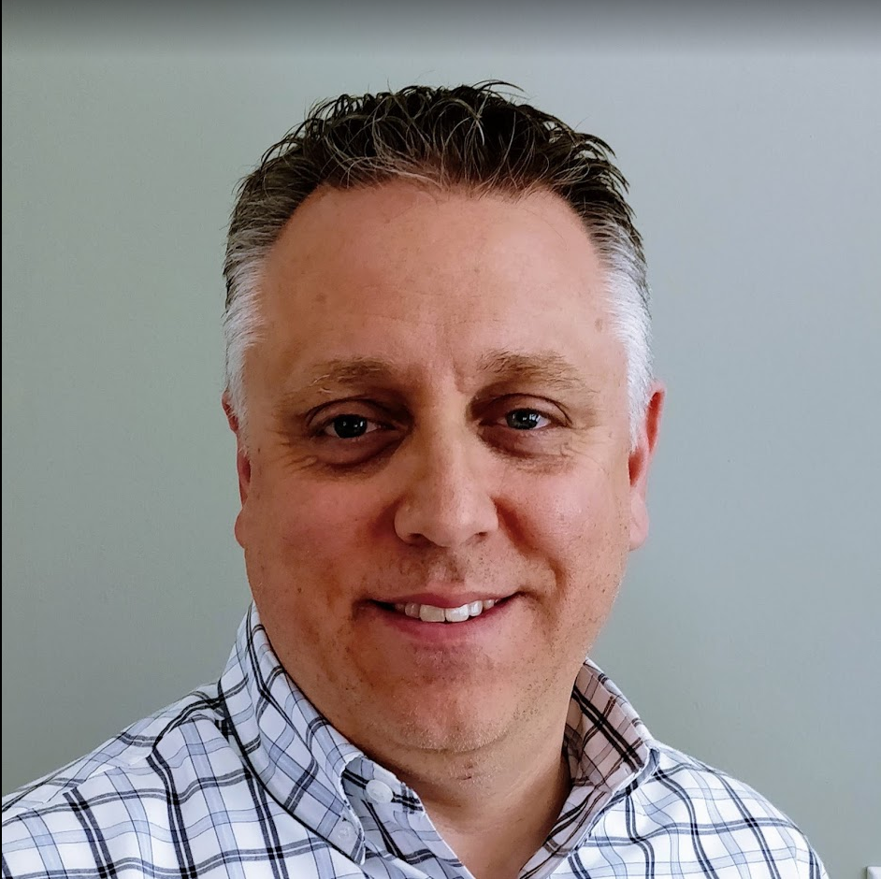
$AboutMe = Get-SpeakerInfo
Twitter: @MikeKanakos
Email: mkanakos@gmail.com
GitHub: github.com/compwiz32
Blog: www.networkadm.in

